Slide 1
Overview of the CLIC study

Slide 2
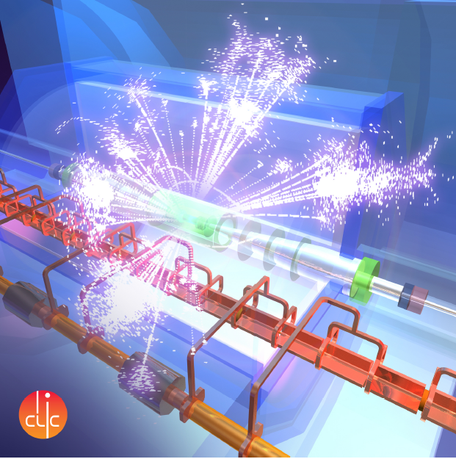
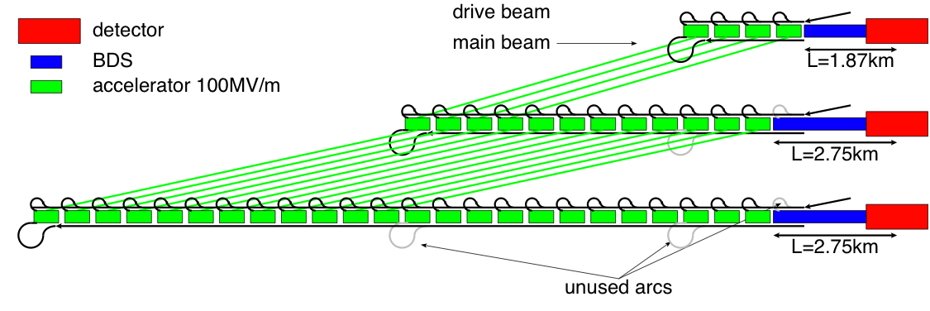
What is CLIC?
A highly developed concept, design and hardware study for a collider capable of delivering e⁺e⁻ physics in the energy decade of 0.3 to 3 TeV – the lepton physics compliment to the LHC.
500 GeV c.m.
1.5 TeV c.m.
3TeV c.m.

Slide 3


























Current CLIC Collaboration
CLIC multi-lateral collaboration - 48 Institutes from 25 countries
Over the last months increased to 48 institutes from 25 countries adding Jerusalem, Belgrade, Alba and Tartu to the list – linked to 2012-2016 work-programme
On-going discussions with 5 more groups …
ACAS (Australia)
Aarhus University (Denmark)
Ankara University (Turkey)
Argonne National Laboratory (USA)
Athens University (Greece)
BINP (Russia)
CERN
CIEMAT (Spain)
Cockcroft Institute (UK)
ETH Zurich (Switzerland)
FNAL (USA)
Gazi Universities (Turkey)
Helsinki Institute of Physics (Finland)
IAP (Russia)
IAP NASU (Ukraine)
IHEP (China)
INFN / LNF (Italy)
Instituto de Fisica Corpuscular (Spain)
IRFU / Saclay (France)
Jefferson Lab (USA)
John Adams Institute/Oxford (UK)
Joint Institute for Power and Nuclear Research SOSNY /Minsk (Belarus)
John Adams Institute/RHUL (UK)
JINR
Karlsruhe University (Germany)
KEK (Japan)
LAL / Orsay (France)
LAPP / ESIA (France)
NIKHEF/Amsterdam (Netherland)
NCP (Pakistan)
North-West. Univ. Illinois (USA)
Patras University (Greece)
Polytech. Univ. of Catalonia (Spain)
PSI (Switzerland)
RAL (UK)
RRCAT / Indore (India)
SLAC (USA)
Sincrotrone Trieste/ELETTRA (Italy)
Thrace University (Greece)
Tsinghua University (China)
University of Oslo (Norway)
University of Vigo (Spain)
Uppsala University (Sweden)
UCSC SCIPP (USA)

Slide 4

Organisation of CLIC detector and physics study
Pre-collaboration structure, based on a “Memorandum on Cooperation”
http://lcd.web.cern.ch/LCD/Home/MoC.html
Light-weight collaborative structure => partners join on “best effort” basis
Organisation resembling most particle physics experiments
Central body is the Institute Board

Slide 5
Primary accelerator features
Reach the high end of the energy range through high, 100 MV/m, accelerating gradient by using short-pulse, around 200 ns, normal-conducting rf.
Deal with the resulting high peak power requirement by going to high rf frequency, X-band, produced by the so-called drive beam scheme. At the lowest energies it is also possible to use klystron/rf pulse compressor units. Accelerating structure input powers are around 250 MW/m.
Deal with the luminosity and resulting high average power requirement by producing, transporting and colliding low-emittance, multi-bunch beams. This requires high-performance damping rings, micron-level main-linac precision and alignment, accelerating structure higher-order-mode damping, nanometer-level main-linac quadrupole stabilization and a sub-nm stabilized final focus etc.

Slide 6
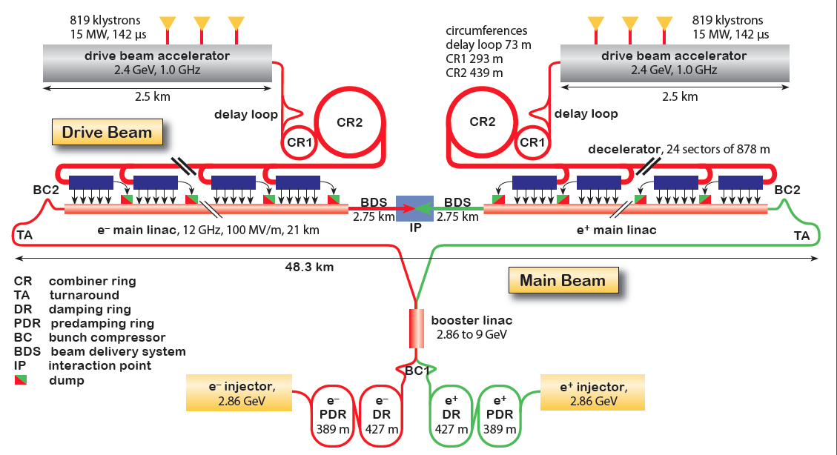
CLIC Layout at 3 TeV
Drive Beam Generation Complex
Main Beam Generation Complex

Slide 7
CLIC Layout at 3 TeV
Drive Beam Generation Complex
Drive beam time structure - initial
Drive beam time structure - final
240 ns
240 ns
5.8 μs
140 μs train length - 24 × 24 sub-pulses
4.2 A - 2.4 GeV – 60 cm between bunches
24 pulses – 101 A – 2.5 cm between bunches
Main Beam Generation Complex

Slide 8
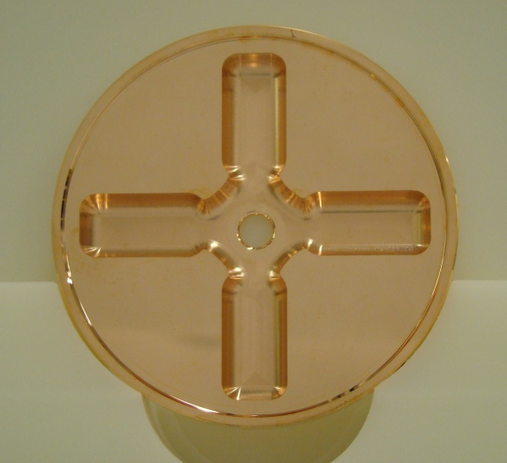
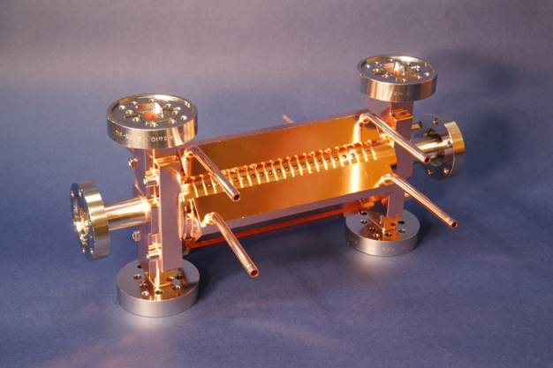
CLIC Layout at 3 TeV
Drive Beam Generation Complex
Main Beam Generation Complex

Slide 9
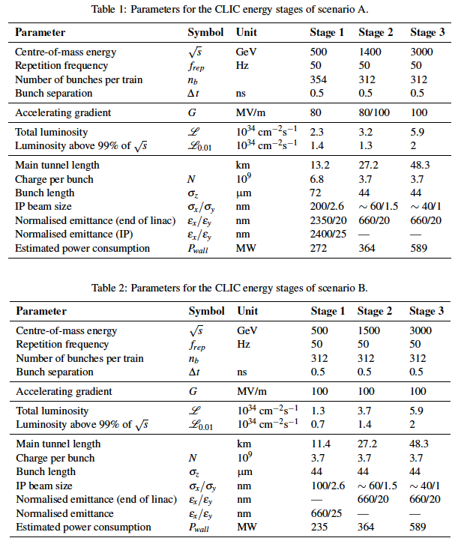
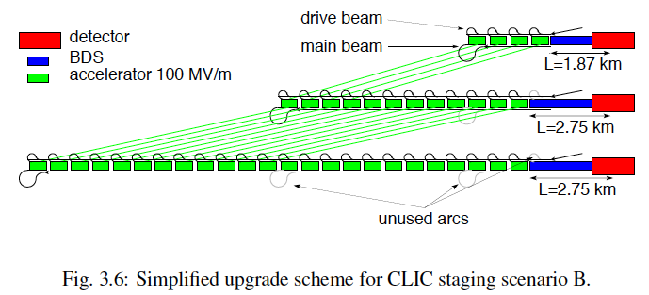
Possible CLIC stages studied
Key features:
High gradient (energy/length)
Small beams (luminosity)
Repetition rates and bunch spacing (experimental conditions)

Slide 10
The physics and accelerator studies of CLIC have been documented in a CDR which was released last year:
Vol 1: The CLIC accelerator and site facilities (H.Schmickler)
- CLIC concept with exploration over multi-TeV energy range up to 3 TeV
- Feasibility study of CLIC parameters optimized at 3 TeV (most demanding)
- Consider also 500 GeV, and intermediate energy range
- Complete, presented in SPC in March 2012 https://edms.cern.ch/document/1234244/
Vol 2: Physics and detectors at CLIC (L.Linssen)
- Physics at a multi-TeV CLIC machine can be measured with high precision, despite challenging background conditions
- External review procedure in October 2011
- Completed and printed, presented in SPC in December 2011 http://arxiv.org/pdf/1202.5940v1
Vol 3: “CLIC study summary” (S.Stapnes)
- Summary and available for the European Strategy process, including possible implementation stages for a CLIC machine as well as costing and cost-drives
- Proposing objectives and work plan of post CDR phase (2012-16)
- Completed and printed, submitted for the European Strategy Open Meeting
in September http://arxiv.org/pdf/1209.2543v1
In addition a shorter overview document was submitted as input to the European Strategy update, available at:
http://arxiv.org/pdf/1208.1402v1

Slide 11
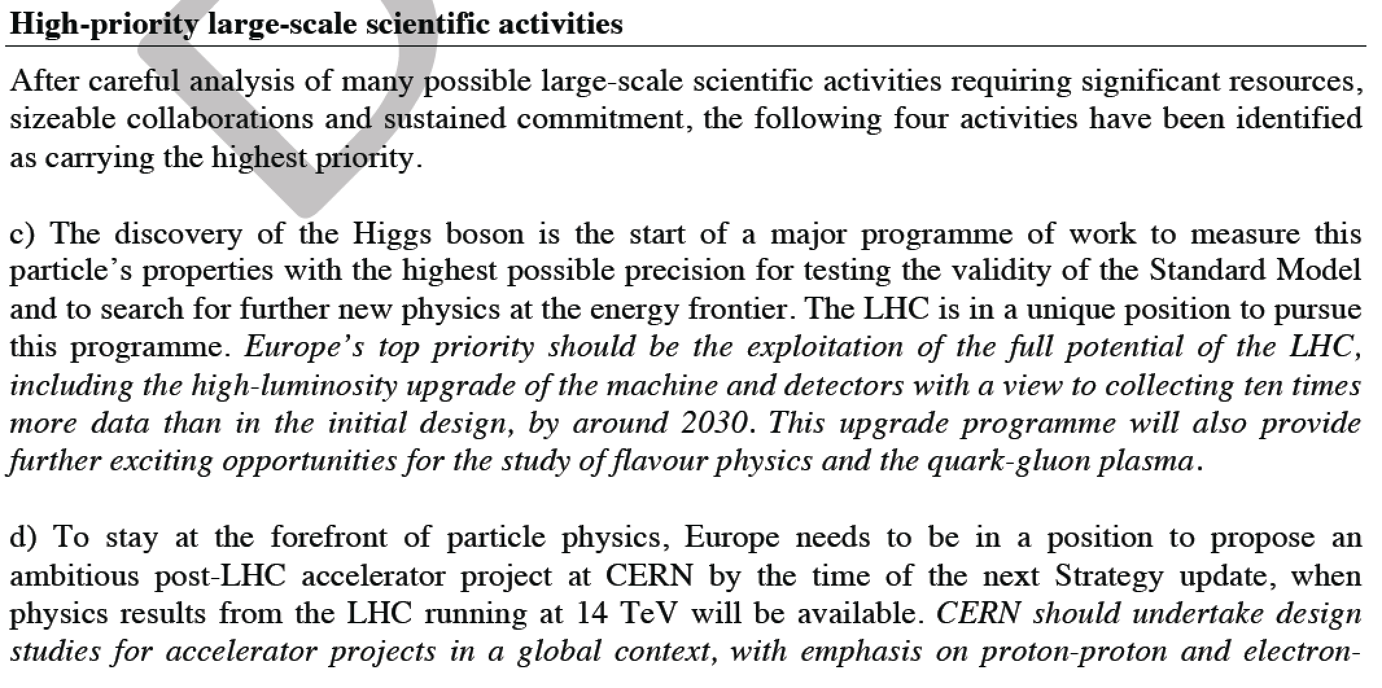
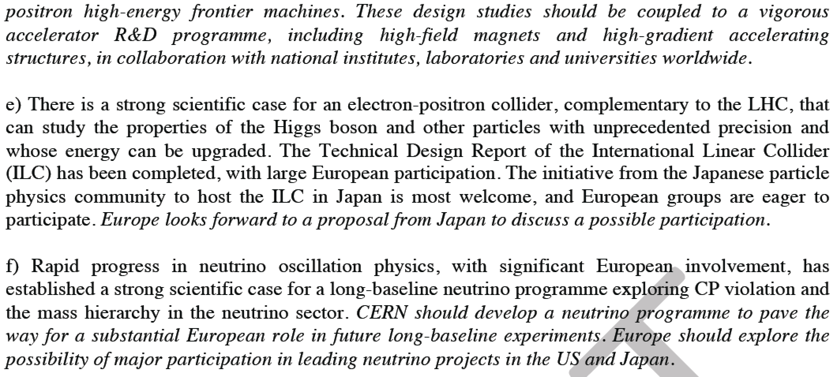

Slide 12
Outline
I will now cover R&D on some of the most critical performance issues of the accelerator.
High-gradient acceleration
Peak power production
Low emittance generation and preservation
A little bit of the detector
Project planning
And using our technology for other applications

Slide 13
100 MV/m gradient X-band accelerating structures

Slide 14

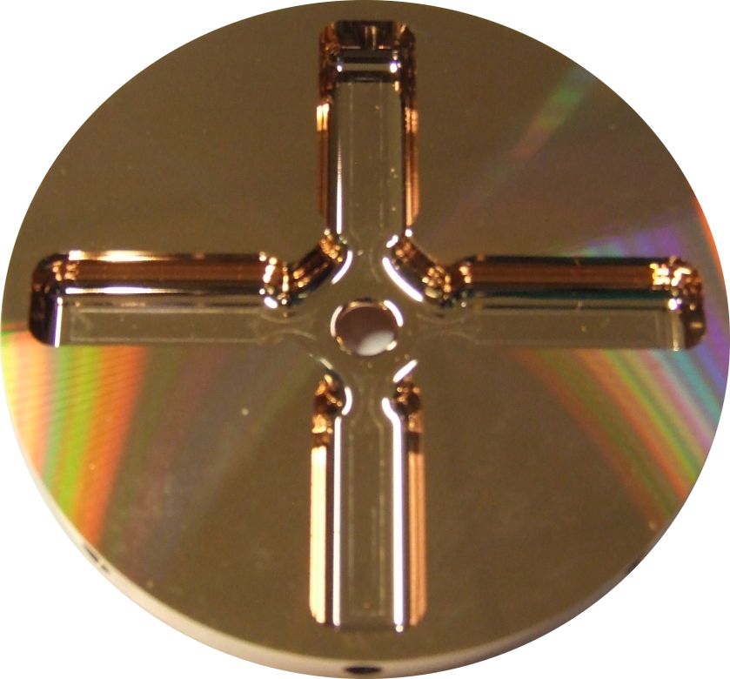
CLIC accelerating structure development
In order to reach 3 TeV with a facility which, for example, could be built in the area around CERN, so < 40 km, an accelerating gradient of around 100 MV/m is required.
In order to maintain low beam emittance along the main linac, accelerating structures must be built with a few micron tolerances and aligned along 10s of meters with roughly 10 micron tolerances.
In addition, in order to provide sufficient luminosity in an energy efficient way, trains of bunches are accelerated. This means that accelerating structures must be equipped with higher order mode in order to suppress long-range wakefields.

Slide 15
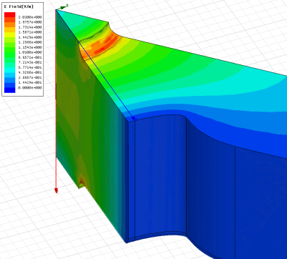
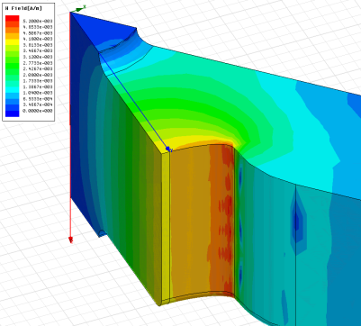
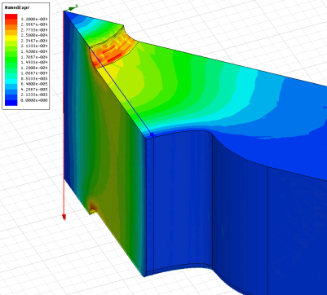
How we got there: High-power design laws
The functions which, along with surface electric and magnetic field (pulsed surface heating), give the high-gradient performance of the structures are:
E_{s}/E_{a}
global power flow
local complex power flow
New local field quantity describing the high gradient limit of accelerating structures.
A. Grudiev, S. Calatroni, W. Wuensch (CERN). 2009. 9 pp.
Published in Phys.Rev.ST Accel.Beams 12 (2009) 102001
H_{s}/E_{a}
S_{c}/E_{a}²

Slide 16
Simplified Parameter Diagram
Parameter Routine
Luminosity, …
Variable | Meaning | Current value
I_{drive} | Drive beam current | 101A
E_{drive} | Drive beam energy | 2.37GeV
τ_{RF} | Main linac RF pulse length | 244ns
N_{sector} | Number of drive beam sectors per linac | 4
N_{combine} | Combination number | 24
f_{r} | Repetition rate | 50Hz
N | Main beam bunch charge in linac | 3.72e9
n_{b} | MB bunches per pulse | 312
n_{cycle} | Spacing between MB bunches | 6 cycles
E₀ | MB energy at linac entrance | 9GeV
E_{cms} | Centre-of-mass energy | 500GeV
G | Main linac gradient | 100MV/m
I_{drive}
E_{drive}
τ_{RF}
N_{sector}
N_{combine}
f_{r}
N
n_{b}
n_{cycle}
E₀
f_{r}
E_{cms,} G, L_{structure}
Two-Beam Acceleration Complex
L_{module}, Δ_{structure}, …
Drive Beam Generation Complex
P_{klystron}, N_{klystron}, L_{DBA}, …
Main Beam Generation Complex
P_{klystron}, …

Slide 17
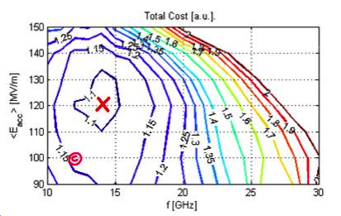
Optimization Ingredients
Define a figure of merit (FoM) to evaluate one given CLIC design/parameter set
  e.g. FoM=-cost
Define a few free parameters to fully describe the design/parameter set
  The other parameters are unambiguously defined by the free parameters
  Currently: gradient G and a few structure parameters (f_{RF}, Δφ, a, Δa, L_{S}, …)
Use optimisation algorithm to find maximum
FoM(free parameters)
  Currently: a simple full search
Allow some human intervention

Slide 18
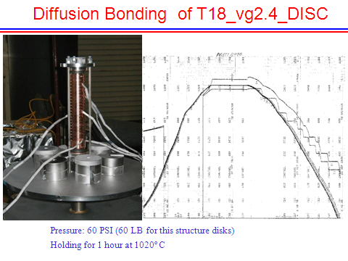
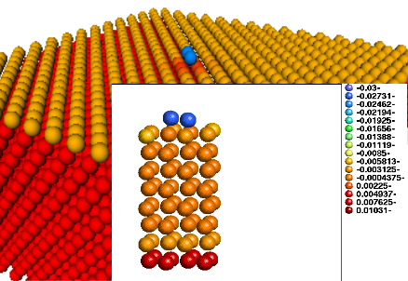
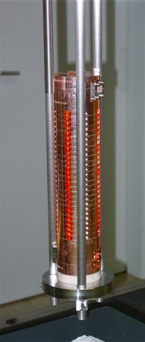
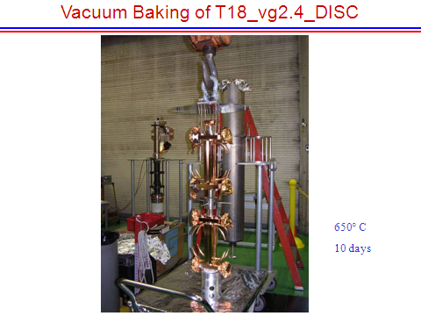
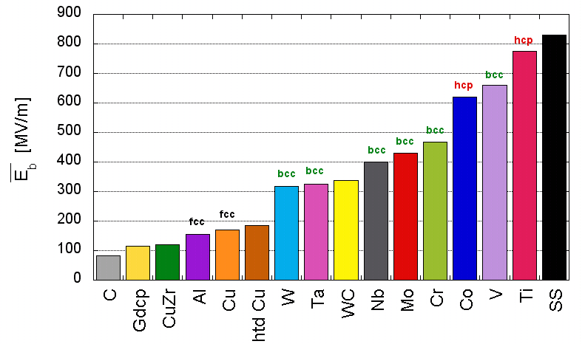
How we got there: heat treatment and material structure
TD18#3 at SLAC
TD18#2 at KEK
Stacking disks
Attempting to understand why it works.
Temperature treatment for high-gradient developed by NLC/JLC

Slide 19
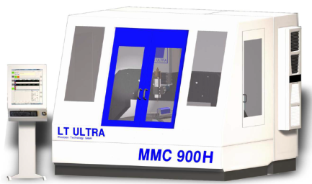
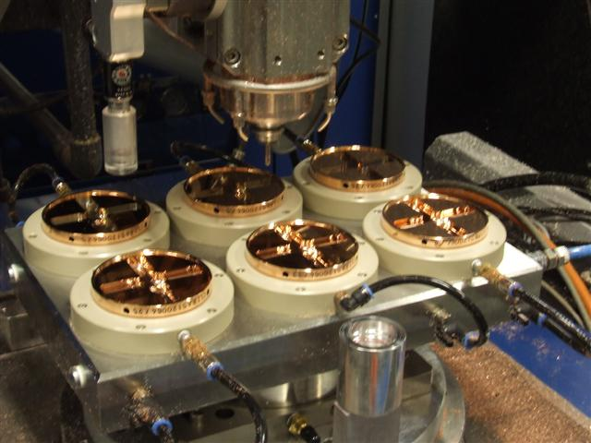
Micron precision turning and milling
Accelerating structure tolerances drive transverse wakefields and off-axis rf induced kicks which in turn leads to emittance growth – micron tolerances required.
Multi-bunch trains require higher-order-mode wakefield suppression – cells require milled features.
High-speed diamond machining also seems to be beneficial for high-gradient performance through minimizing induced surface stresses.
Development done “in industry”

Slide 20
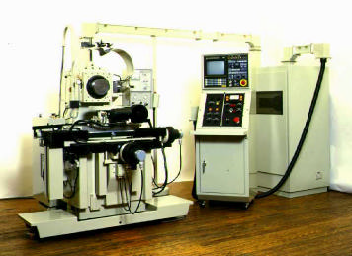
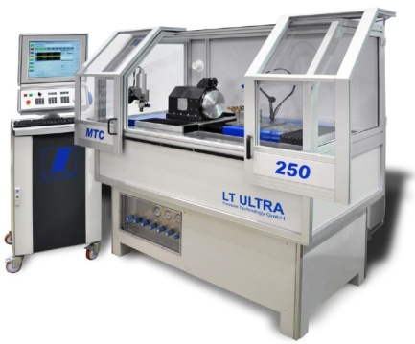
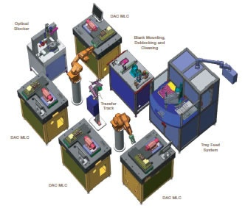
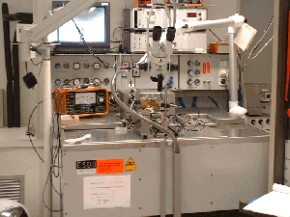
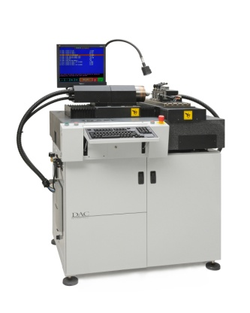
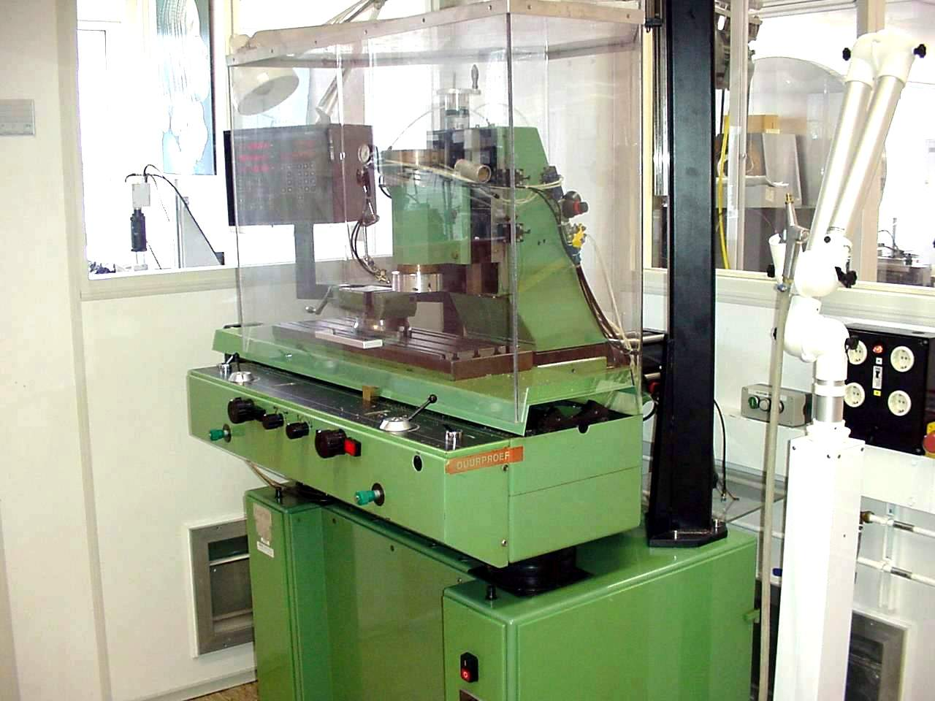
Evolution of machining capability
Single point diamond turning
Up to the 1980’s
1980’s - 1990’s
2000’s - 2010’s
Future ?
First machines at research institutes and universities
Start of industrialization
Optical recording
contact lenses
Larger machines
Multiple axis ( X/Y/Z and C)
Intelligent machines ?
  Robotisation ?
Ultra precision diamond milling (lagging more than a decade behind on turning)
Up to the 1990’s
1990’s - 2000’s
2010’s
Future ?
Limited to fly cutting
mirror optics
Laser scanner mirrors
Milling as add-on on lathes
Lens arrays
Intra ocular lenses
First proto type machines
Micro fluidics
Accelerator parts
Pallet machining?
  Robotisation ?

Slide 21
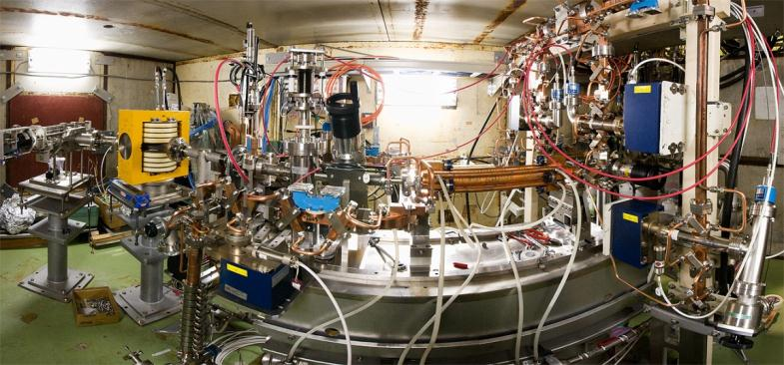
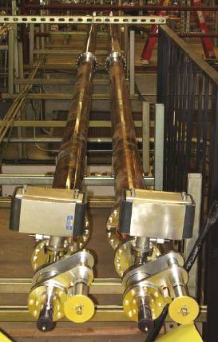
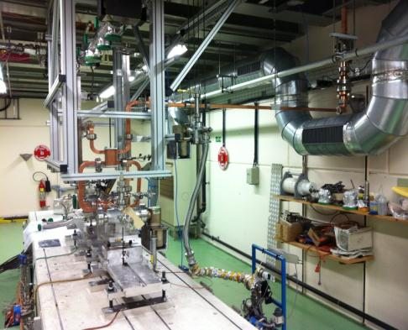
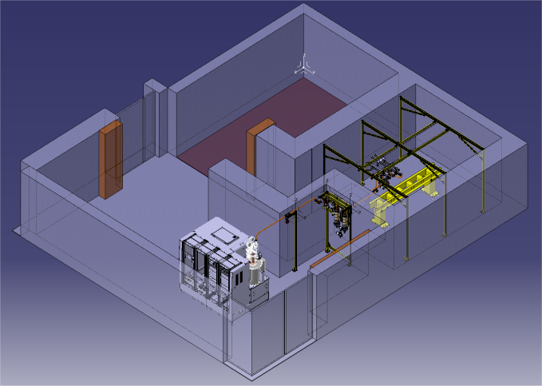
Klystron-based test stands for CLIC
NEXTEF at KEK
XBox1 at CERN
ASTA at SLAC?
Xbox-2 at CERN based on XL-5
Xbox-3 at CERN based on 6 MW tube

Slide 22
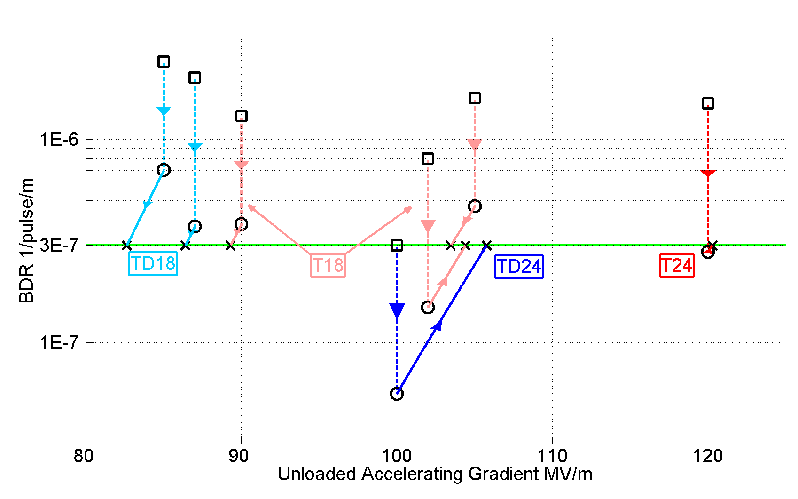
Accelerating gradients achieved in tests.
Status: 4-9-2012
KEK production/test
HOM damped

Slide 23
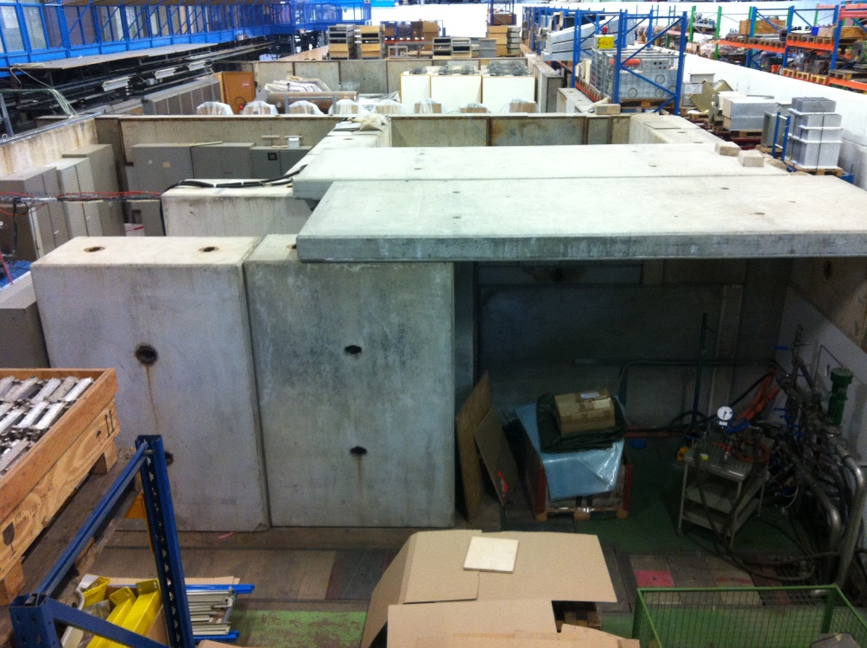
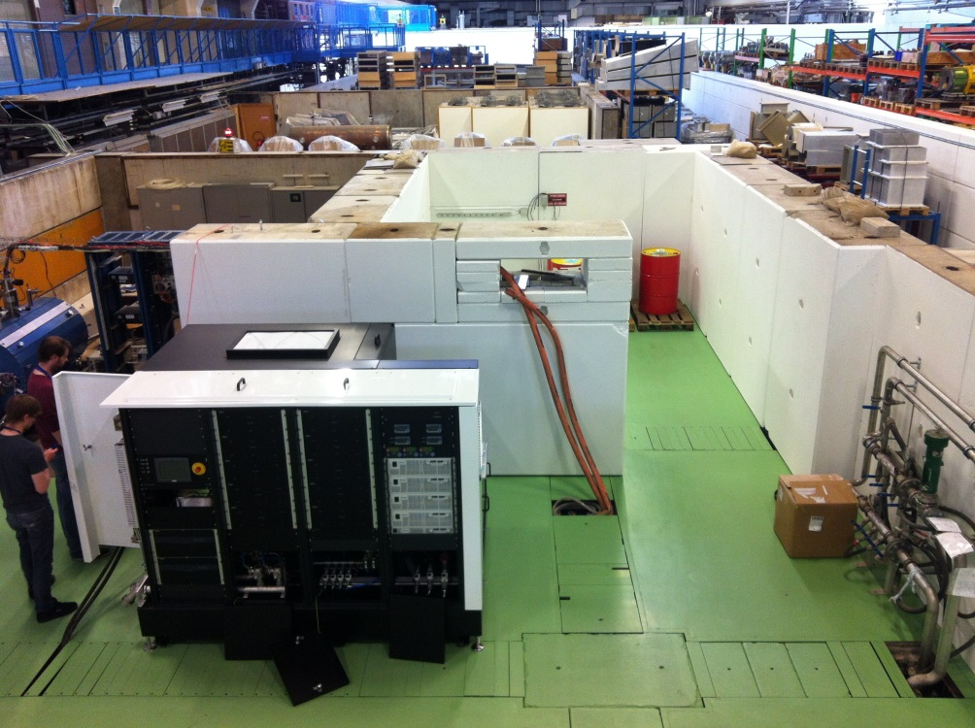
Site preparation
21.02.2013
08.05.2013
Pre-approved by safety for radiation and seismic risks (more to come)
Shielding reinforced, area cleared,
Utilities to be deployed during summer
Modulator in place. Walls to be closed now.
Continuous work

Slide 24
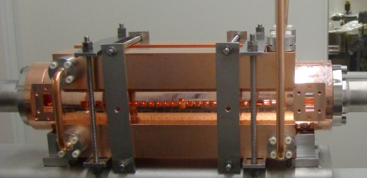
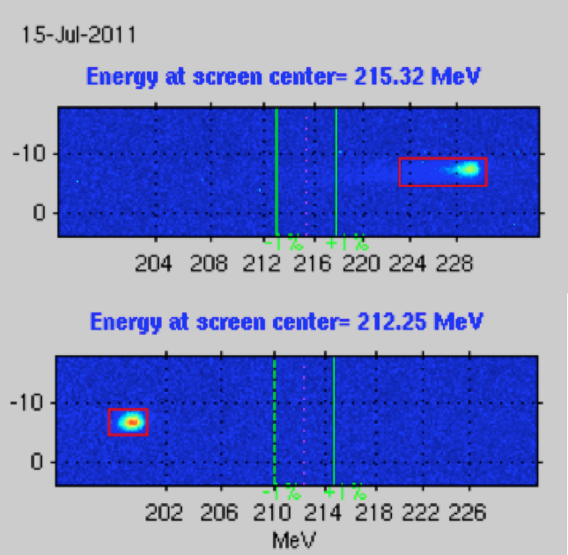
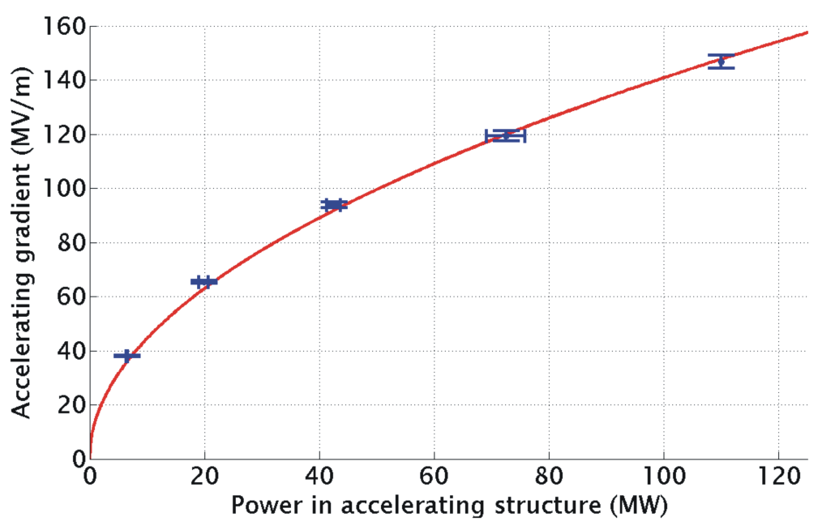
Two-Beam Acceleration
Two-Beam Acceleration demonstration in TBTS
Up to 145 MV/m measured gradient
Good agreement with expectations (power vs. gradient)
TD24
Maximum stable probe beam acceleration measured: 31 MeV
⇒ Corresponding to a gradient of 145 MV/m
Drive beam ON
CLIC Nominal, unloaded
CLIC Nominal, loaded
Drive beam OFF

Slide 25
Power production: Two-beam scheme

Slide 26
Drive-beam power production
The basic idea:
To feed all the energy the collider needs into a long 140 μs, 4.2 A, 2.4 GeV bunched train using 1 GHz rf klystrons and fully loaded low gradient accelerating structures. Very efficient!
Do ‘beam pulse compression’ using a delay loop and combiner rings to take the current up to 100 A. Counter feed these pulses from the accelerator center, which is another step of pulse compression.
Decelerate the beam in 25 cm long low-impedance rf structures called PETS (Power Extraction and Transfer Structures) to produce output powers of 120 MW to feed two accelerating structures.
To test all this, as close as we can to full specifications, we have a test facility called CTF3.

Slide 27
CLIC Layout at 3 TeV
Drive Beam Generation Complex
Main Beam Generation Complex

Slide 28
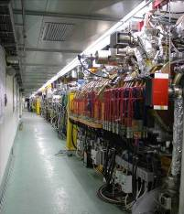
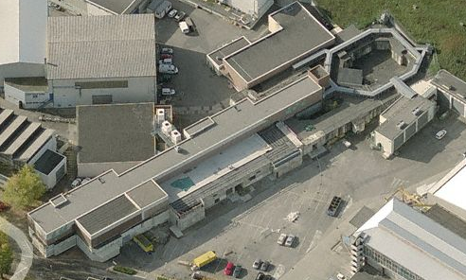
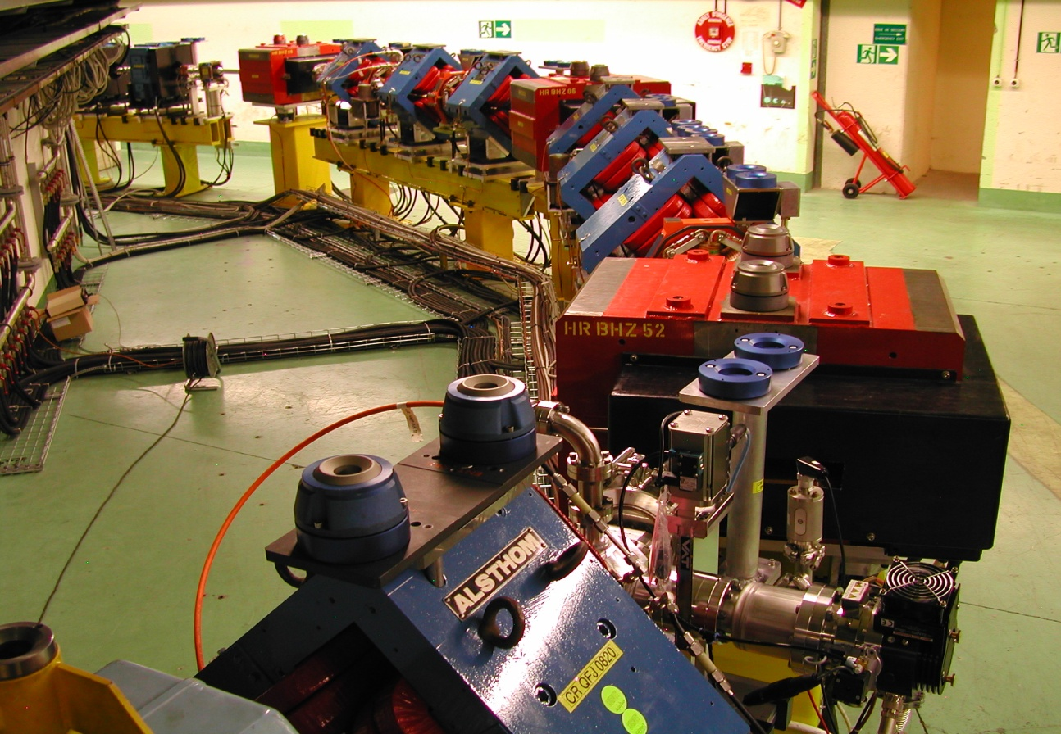
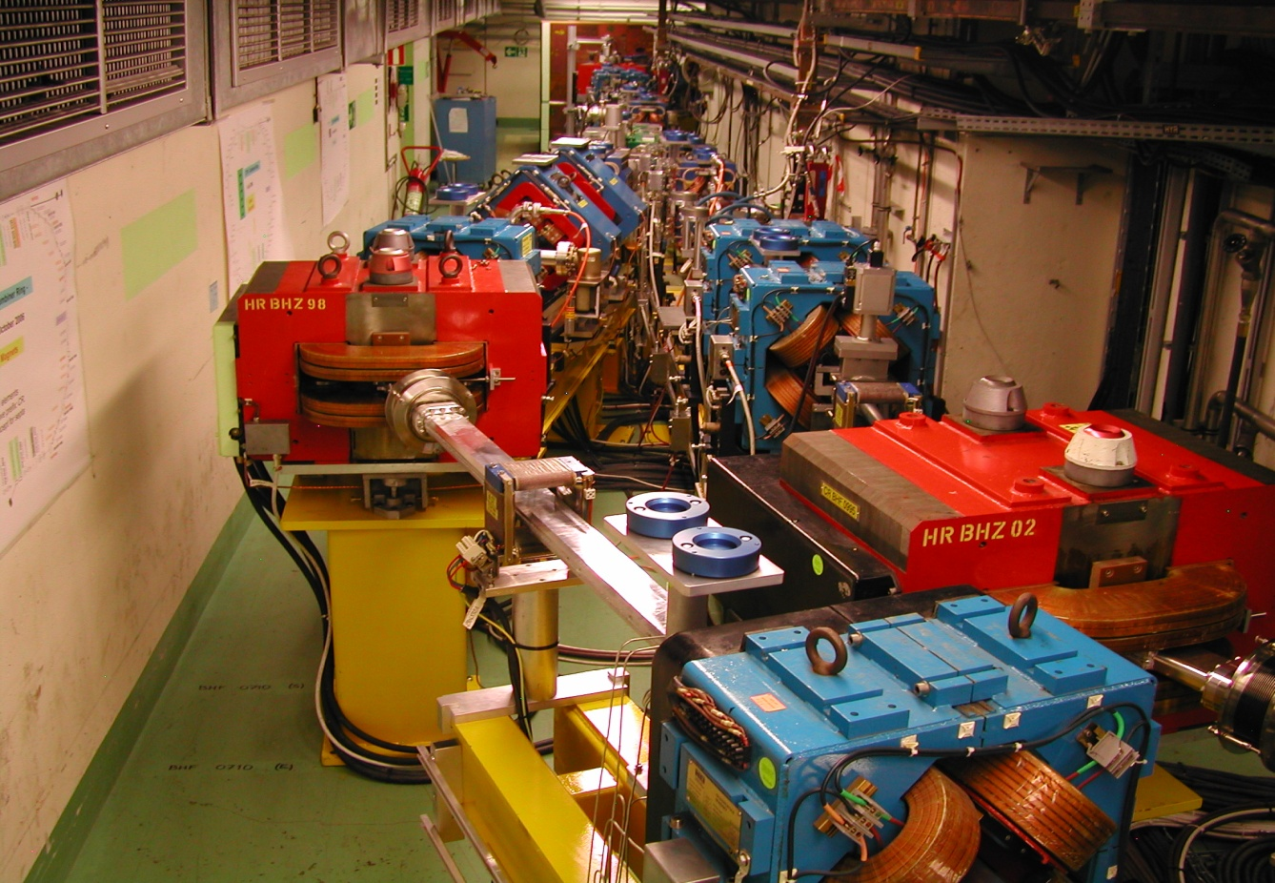
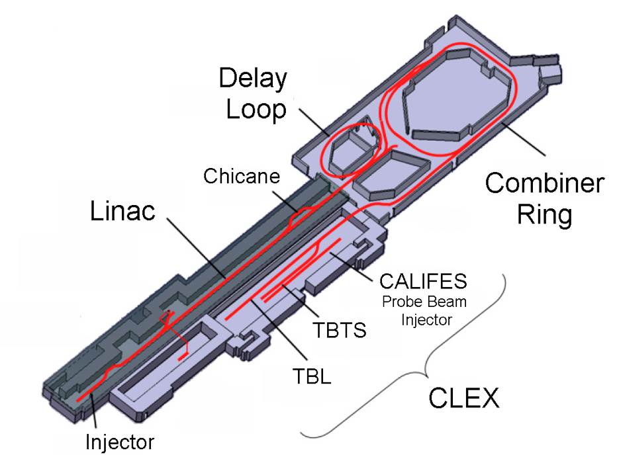
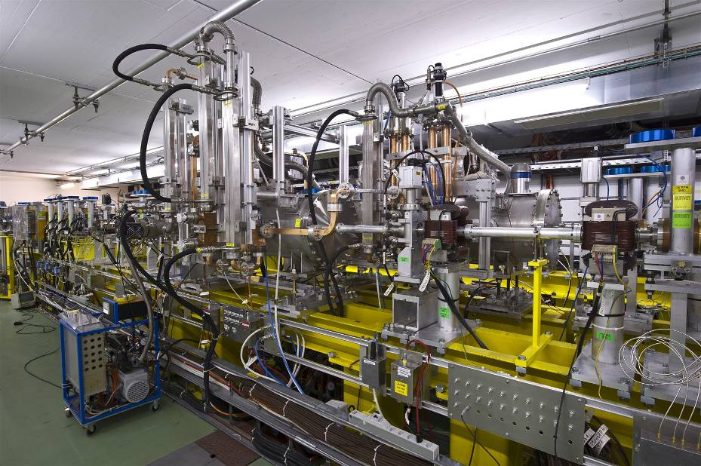
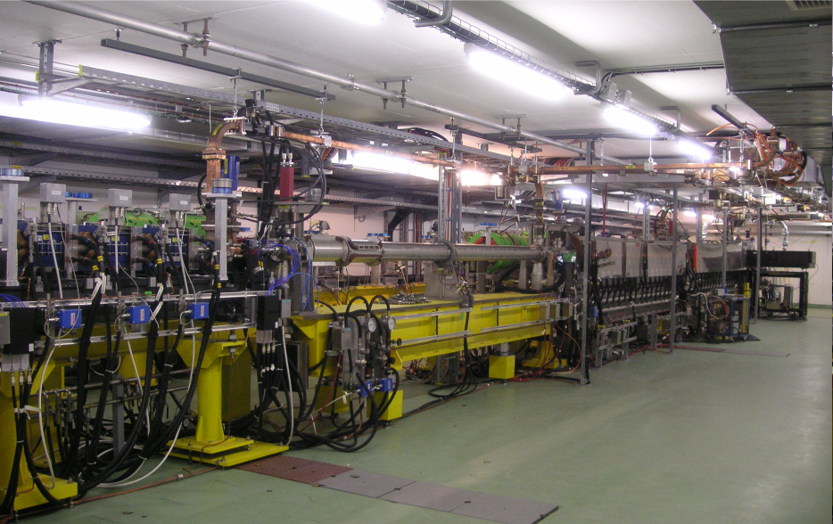
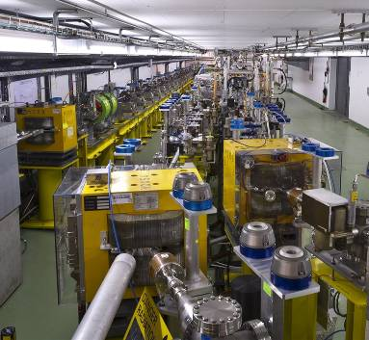
CLIC Test Facility (CTF3)
Operation of isochronous lines and rings
4 A, 1.4us
120 MeV
30 A, 140 ns
120 MeV
High current, full
beam-loading operation
Beam recombination and current multiplication by RF deflectors
12 GHz power generation by drive beam deceleration
High-gradient two-beam acceleration
30 A, 140 ns
60 MeV
Bunch phase coding

Slide 29
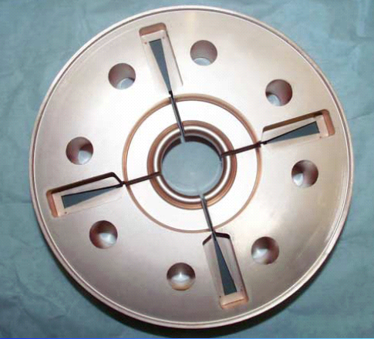
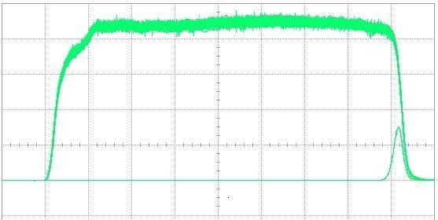
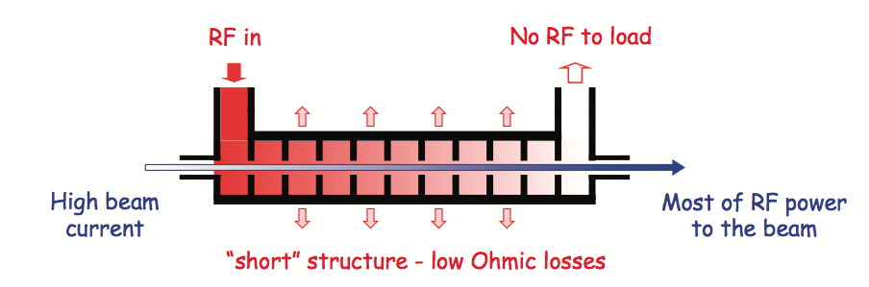
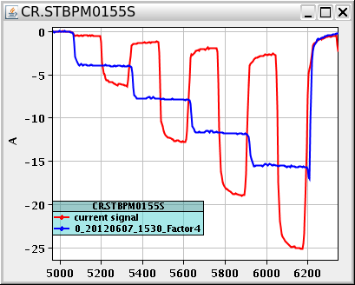
Drive Beam Generation
damping
slot
Full beam loading acceleration
95.3% RF to beam efficiency
Stable high current acceleration
Current stability
Isochronicity, phase coding
Factor 8 current & frequency multiplication
RF pulse at structure input
10 m
RF pulse at output
SiC load
RF in
No RF to load
High beam current
Most RF power
to beam
“short” structure – low Ohmic losses
Pulse charge measurement
Factor 8 combination

Slide 30
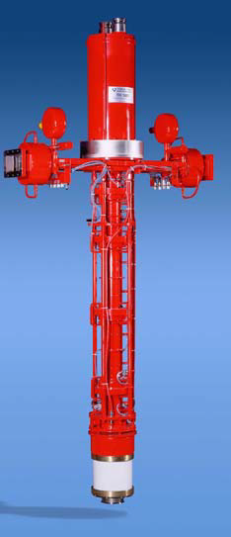




L-band klystron development
CLIC drive beam klystron not so different from ILC klystron but at 1 GHz (ILC 1.3 GHz) and with a target efficiency of 70% (ILC 65%), 140 μs (ILC 1.5 ms) and a higher peak power around 15-20 MW (ILC 10 MW).
ILC 1.3 GHz multi-beam klystrons
Detailed scaling studies now beginning to understand potential performance based on existing technology.

Slide 31




PETS – fundamental mode characteristics
Beam-driven structure so power rises quadratically with current and length,
135 MW for 100 A beam
213 mm active length
Maximum fields at output with values,
E_{surf}=56 MV/m
ΔT=1.8 (H_{surf}=0.08 MA/m)
S_{c}=1.2 MW/mm²
Surface electric field
Surface magnetic field

Slide 32









ASTA test PETS version with damping slots and damping material (SiC)
load
Low RF power measurements
Reflection
Transmission
June 2010

Slide 33



Power Production & Drive Beam Deceleration
TBTS:
Power production in PETS (P_{out}≈ 200MW)
Breakdown rates checked
On-off mechanism tested successfully
TBL:
13 PETS installed
Up to 21 A current transported
optics understood - no losses
Good agreement current/RF/deceleration
~ 26% deceleration
(Final goal is 40% deceleration)
Measurements at SLAC:
No breakdown last O(8 10⁶ pulses)
-> P consistent with p≤10⁻⁷/m/pulse
PETS – Power Extraction & Transfer Structure
TBL line in CLEX
~ 30 MeV
26%
More than half a GW of 12 GHz power!
33

Slide 34





Putting it all together: Two-Beam Modules
Next Steps:
Complete modules being assembled in lab and for beam-tests
Installation and test of full-fledged Two-Beam Modules in CLEX
First module in development, installation end 2013
Three modules in 2014-2016
Maximum stable probe beam acceleration measured: 31 MeV
⇒ Corresponding to a gradient of 145 MV/m
Drive beam ON
CLIC Nominal, unloaded
CLIC Nominal, loaded
Drive beam OFF

Slide 35
Another option for low energies, e.g. 350 GeV:
X-band klystron driven linear collider

Slide 36





KMD and X-Band Overview, January 5, 2011 Erik Jongewaard
X-band klystrons (industrialized)
Klystron XL4 series
design
Klystron XL5 series
5 tubes have been fabricated at SLAC (1.5 are in operation). The first tube is ordered from industry (CPI)
Efficiency
32.5%
performance
18 tubes built to date (not counting rebuilds)
CLIC’k target
CLIC’k klystron:
59 MW
418 kV, 324 A (µK=1.2)
Efficiency 0.436
CLIC’k klystron:
59 MW
404 kV, 308 A (µK=1.2)
Efficiency 0.474

Slide 37




PPM focusing vs. Superconducting Solenoids
PPM, KEK
1994
…A superconducting focusing solenoid system for an X band klystron has been developed. The system consists of a conduction cooled superconducting solenoid, a GM refrigerator and high Tc material current leads. The system cools down to the operation temperature of about 4 K by 4 days just by turning on the refrigerator….
In the past 2 decades, the SC technology has progressed a lot. It is worth revising the use of SC (cryogen-free) solenoids for the klystrons again. If cost effective, such an approach will bring benefits for the technology as a whole.

Slide 38




Designing the linac
Klystron peak power for the fixed layout: 2 x Kl(PPM)+PC -> 6 x structures
Scaled (244 ns) 12 GHz DM SLED II performance
XL5 klystron measured
CLIC_G
_502
_1
_2
RF transport efficiency 0.9 is included
50 Hz
Case | CLIC_G | CLIC_502 | #1 | #2
Gradient, MV/m | 100 | 80 | 67 | 57
Length, m | 0.23 | 0.23 | 0.48 | 0.48
P peak, MW | 61.3 | 74.2 | 84 | 76
Efficiency, % | 28.5 | 39.6 | 41.9 | 49.5
F. Merit [a.u.] | 3.81 | 3.3 | 2.79 | 3.41
Used input: Klystron efficiency 0.55 (measured). Modulator efficiency 0.7 (expected)

Slide 39


CLIC’k RF unit layout
The alternative PC schemes certainly must be considered (especially for the low energy machine), but for our evaluation, we will keep DM SLED II as a base line option, as its performance was confirmed through the high RF power testing.
2-pack solid state modulator
PPM klystrons
460 kV, 2 μs flat top
59 MW
1.95 μs
118 MW
1.95 μs
x 4.64
~17.7 m, ∅16.3 cm
TE01 transfer line (? m)
TE01 90⁰ bend
Inline RF distribution network
492 MW
244 ns
Common vacuum network
x 8 accelerating structures,
100 MV/m loaded gradient
2 m, 1.83 active
Compared to NLC, the energy gain per unit in CLIC’k case is 26% lower (need more klystrons per meter), but the unit active length is ~ 2 time shorter.

Slide 40
Low emittance and luminosity

Slide 41



Emittance Generation
Many design issues addressed:
lattice design
dynamic aperture
tolerances
intra-beam scattering
space charge
wigglers
RF system
vacuum
electron cloud
kickers
In addition: wiggler and kicker developments
SSRF
CLIC @3 TeV would achieve 1/3 of nominal luminosity with ATF performance
(3800nm/15nm@4e9)
Damping ring design is consistent with target performance

Slide 42







Main Linac Tolerances
Stabilise quadrupole
O(1nm) @ 1Hz
Pre-align BPMs+quads
accuracy O(10μm) over about 200m
BBA in FACET at SLAC
characterize 500m part
apply orbit correction proc.
3) Use wake-field monitors accuracy O(3.5μm)
2) Beam-based alignment
Test of prototype shows
  vertical RMS error of 11μm
  i.e. accuracy is approx. 13.5μm

Slide 43



T501: BBA studies at SLAC
T501: FACET test-beam proposal to study advanced global correction schemes for future linear colliders.
CERN-SLAC collaboration where algorithms developed at CERN are tested on the SLAC linac.
The study includes linac system identification, global orbit correction and global dispersion correction.
Successful system identification and global orbit correction has been demonstrated on a test-section of 500 m of the linac.
The section of the SLAC beamlines we work on
RESULT: Example of global orbit correction of a test-section of the SLC linac:
(above) Horizontal and Vertical trajectories before and after orbit correction
(Above) Measured Rx response matrix for the test-section of the linac (17 correctors, 48 BPMs)
(above) Iterations of orbit correction: convergence of the algorithm

Slide 44




Active Stabilization
Typical quadrupole jitter tolerance O(1nm) in main linac and O(0.1nm) in final doublet
Final Focus QD0 Prototype
Luminosity achieved/lost [%]
 | B10
No stab. | 53%/68%
Current stab. | 108%/13%
Future stab. | 118%/3%
Code
Machine model
Beam-based feedback
Close to/better than target

Slide 45
A very little bit about detectors

Slide 46

CLIC Detectors – in brief
Instrumented return yoke
for muon ID
Complex forward region with final beam focusing
Strong SC solenoid
4 T or 5 T
Fine grained calorimeters for PFA: 1 + 7.5 λ_{int}
6.5 m
Ultra low-mass
vertex detector
with 20 μm pixels
Tracking:
TPC+silicon (CLIC_ILD)
all-silicon (CLIC_SiD)
Detailed GEANT 4 simulation
Studied using full reconstruction with background

Slide 47


CLIC machine environment
 | CLIC at 500 GeV | CLIC at 3 TeV
L (cm⁻²s⁻¹) | 2.3×10³⁴ | 5.9×10³⁴
BX separation | 0.5 ns | 0.5 ns
#BX / train | 354 | 312
Train duration (ns) | 177 | 156
Rep. rate | 50 Hz | 50 Hz
σ_{x} / σ_{y} (nm) | ≈ 200 / 2.3 | ≈ 45 / 1
σ_{z} (μm) | 72 | 44
Drives timing
requirements
for CLIC detector
Simplified view:
Pair background
Design issue
gg → hadrons
Impacts on the physics
Needs suppression in data
Beam related background:
Small beam profile at IP leads to very
high E-field
  Beamsstrahlung
    Pair-background
    γγ to hadrons

Slide 48
background suppression at CLIC
Triggerless readout of full train
 t₀ physics event (offline)
Full event reconstruction + PFA analysis with background overlaid
  => physics objects with precise p_{T} and cluster time information
  Time corrected for shower development and TOF
Then apply cluster-based timing cuts
  Cuts depend on particle-type, p_{T} and detector region
  Allows to protect high-p_{T} physics objects
tCluster
tCluster
+
Use well-adapted jet clustering algorithms
  Making use of LHC experience (FastJet)

Slide 49


combined p_{T} and timing cuts
1.2 TeV
100 GeV
1.2 TeV background in reconstruction time window
100 GeV background after tight cuts

Slide 50
The coming years and project implementation

Slide 51

CLIC physics potential
LHC complementarity at the energy frontier:
How do we build the optimal machine given a physics scenario (partly seen at LHC ?)
Examples highlighted in the CDR:
Higgs physics (SM and non-SM)
Top
SUSY
Higgs strong interactions
New Z’ sector
Contact interactions
Extra dimensions
Detailed studies at 350, 500, 1400,
1500 and 3000 GeV for these processes
Stage 1: ~500 (350) GeV => Higgs and top physics
Stage 2: ~1.5 TeV => ttH, ννHH + New Physics (lower mass scale)
Stage 3: ~3 TeV => New Physics (higher mass scale)

Slide 52
CLIC Implementation – in stages?
Need to operate at
lower than nominal energy
CLIC two-beam scheme compatible with energy staging to provide the optimal machine for a large energy range
Lower energy machine can run most of the time during the construction of the next stage.
Physics results will determine the energies of the stages
Linac 1
I.P.
Linac 2
0.5 TeV Stage
Injector
Complex
4 km
4 km
~14 km
Linac 1
I.P.
Linac 2
1-2 TeV Stage
Injector
Complex
7.0-14 km
7.0-14 km
~20-34 km
Linac 1
3 TeV Stage
I.P.
Linac 2
Injector
Complex
20.8 km
3 km
3 km
20.8 km
48.2 km

Slide 53


CLIC near CERN
Tunnel implementations (laser straight)
Central MDI & Interaction Region

Slide 54
Implementation issues
Physics - how do we build the optimal machine given a physics scenario (partly seen at LHC ?):
Understand the benefits of running close to thresholds versus at highest energy, and distribution of luminosities as function of energy
Construction scenario (and approval scenario):
Explore how we in practice will do the tunneling and productions/installation/movement of parts in a multistage approach ? Environmental impact study
Timescale/lifecycle for project re-defined: Buildup of drive beam (CLIC zero), stage one – physics, more stages/extensions
Parameters: energy steps and scans, inst. and int. luminosities, commissioning and lum. ramp up times.
Power and energy development.
Have started to work on energy estimates (not only max power at max luminosity and the highest energy) based on running scenarios and power on/off/standby estimates
Costs - Initial machine plus energy upgrade: External cost review 21-22.2.2012, costs discussed in volume 3 of the CDR

Slide 55

Schedule first two stages
coord. along collider
year

Slide 56

Costs
First to second stage: 4 MCHF/GeV (i.e. initial costs are very significant)
Caveats:
  Uncertainties 20-25%
  Possible savings around 10%
  However – first stage not optimised (work for next phase), parameters largely defined for 3 TeV final stage

Slide 57


CLIC project time-line

Slide 58
Not the main line but a growing theme – applying CLIC technology to other projects.
I will now show a few slides on a proton cancer therapy application.
But we try to work more and more with XFELs, Compton sources etc.

Slide 59

Design project B: cyclinac for single-room proton facility

Slide 60

TULIP 24 – baseline design
230 MeV
24 MeV

Slide 61





Backward wave high-gradient accelerating structure for proton acceleration based on CLIC technology

Slide 62
Thank you for the opportunity to speak and your attention!

Slide 63
Part 3 – High-gradient physics

Slide 64
Breakdown Physics
I would like to start this part my presentation with what I believe are some of the essential questions which motivate and direct our study of breakdown – the primary effect which limits the gradient in normal conducting accelerating structrures.
I will then describe some recent progress in answering those questions.
Why bother understanding? Breakdowns happen anyway.
What features on, or near, a surface cause a breakdown to occur at a particular place? How do these features form? What causes the features to begin the run-away process we detect as breakdown? Which leads to the question,
Where does the breakdown rate come from? What gives the principle dependencies – breakdown rate on gradient and pulse length?

Slide 65
Why bother understanding? Breakdowns happen anyway.
We observe a very strong dependence of achievable accelerating gradient on the rf geometry. Linac parameters are also a strong function of rf geometry: wakefields, shunt impedance, rf to beam efficiency etc.
Being able to predict the gradient a given structure will achieve (based on a specific technology) allows us to optimize the overall design of the accelerator. This dependence is not simply the surface electric field…
Parameter Routine
Luminosity, …
CLIC re-baselining exercise currently underway.
I_{drive}
E_{drive}
τ_{RF}
N_{sector}
N_{combine}
f_{r}
N
n_{b}
n_{cycle}
E₀
f_{r}
E_{cms,} G, L_{structure}
Two-Beam Acceleration Complex
L_{module}, Δ_{structure}, …
Drive Beam Generation Complex
P_{klystron}, N_{klystron}, L_{DBA}, …
Main Beam Generation Complex
P_{klystron}, …

Slide 66


Maximum surface electric and magnetic fields
Waveguide
damped
Es = 220 - 250 MW/mm²

Slide 67
High-power design laws
The functions which, along with surface electric and magnetic field (pulsed surface heating), give the high-gradient performance of the structures are:
E_{s}/E_{a}
global power flow
local complex power flow
New local field quantity describing the high gradient limit of accelerating structures.
A. Grudiev, S. Calatroni, W. Wuensch (CERN). 2009. 9 pp.
Published in Phys.Rev.ST Accel.Beams 12 (2009) 102001
H_{s}/E_{a}
S_{c}/E_{a}²

Slide 68
Accelerating gradients achieved in tests.
Status: 4-9-2012
HOM damped

Slide 69


Power flow related quantities: Sc and P/C
Sc = 4 - 5 MW/mm²
P/C = 2.3 – 2.9 MW/mm

Slide 70
What features on, or near, a surface cause a breakdown to occur at a particular place?
Our field has depended on the proverbial field emission “tip” with the corresponding field enhancement factor β in order to reconcile observed field emission with the Fowler-Norheim equation.
We keep talking about these tips even though no-one has ever taken pictures of them nor can anyone predict the β a surface will have except through field emission.
Typical values of β in our high gradient accelerating structures are in the range of 50-100.
But there can be more than geometrical field enhancement…
Surface-Emission Studies in a High-Field RF Gun based on Measurements of Field Emission and Schottky-Enabled Photoemission H. Chen, Y. Du, W. Gai, A. Grudiev, J. Hua, W. Huang, J. G. Power, E. E. Wisniewski, W. Wuensch, C. Tang, L. Yan, and Y. You
Phys. Rev. Lett. 109, 204802 – Published 14 November 2012

Slide 71

Electron emission
Fowler Nordheim Law (RF fields):
I_{FN}
(β, φ₀, A_{e}, E₀)
High field enhancements (β) can field emission.
Low work function (φ₀) in small areas can cause field emission.
typical picture ➔
geometric perturbations (β)
alternate picture ➔
material perturbations (φ₀)
grain
boundaries
peaks
oxides
cracks
Copper surface
inclusions
(suggested by Wuensch and colleagues)

Slide 72


Slide 73



Electrodynamics-molecular dynamic model+ study of a void under tensile stress
Details in F. Djurabekova, S. Parviainen, A. Pohjonen and K. Nordlund, PRE 83, 026704 (2011).
ED-MD model follows the evolution of the charged surface.
The dynamics of atom charges follows the shape of electric field distortion on tips on the surface
We also studies the dislocation dynamics on a void burrowed near the surface in Cu held under unilater tensile stress.
A. Pohjonen, F. Djurabekova, et al., Jour. Appl. Phys. 110, 023509 (2011).

Slide 74


“Catastrophic”growth of a protrusion at the void
. the top view and a slice of the system at time t = 130 ps when the fully developed protrusion is clearly visible.

Slide 75




Deformation at realistic electric field strength
Void formation starts at fields > 400 MV/m
Material is plastic only in the vicinity of the defect
Thin slit may be formed by combination of voids or by a layer of fragile impurities
Field enhancement factor ~2.4
Thin material layer over the void acts like a lever, decreasing the pressure needed for protrusion formation
Vahur Zahdin

Slide 76


Slide 77


Slide 78



DC Spark System Turn on Time
Sample size = 50
The spread in voltage fall times (and current rise times) is extremely small compared to the RF case.
The measured current rise time always shorter than voltage fall time due to initial charging current overlap.

Slide 79
Summary of turn on times
Test | Frequency | Measurement | Result
Simulation |  |  | 0.25ns
New DC System | DC | Voltage Fall Time | 12-13ns
Swiss FEL (C-Band) | 5.7GHz | Transmitted Power Fall Time | 110 - 140ns
KEK T24 (X-Band) | 12GHz | Transmitted Power Fall Time | 20-40ns
CTF/TBTS TD24 (X-Band) | 12GHz | Transmitted Power Fall Time | 20-40ns
CTF SICA (S-Band) | 3GHz | Transmitted Power | 60-140ns
The turn on time does not seem to be related to the bandwidth of the structures but to the frequency or possibly the intrinsic size.

Slide 80

Relevant data points of BDR vs Eacc
TD18
Steep rise as Eacc, 10 times per 10 MV/m, less steep than T18
T. Higo, KEK

Slide 81

TD18_#2 BDR versus width at 100MV/m around 2800hr and at 90MV/m around 3500hr
TD18
Similar dependence at 90 and 100 if take usual single pulse?
T. Higo, KEK

Slide 82

What are the field emitters?
Why do we look for dislocations?
The dislocation motion is strongly bound to the atomic structure of metals. In FCC (face-centered cubic) the dislocation are the most mobile and HCP (hexagonal close-packed) are the hardest for dislocation mobility.
A. Descoeudres, F. Djurabekova, and K. Nordlund, DC Breakdown experiments with
cobalt electrodes, CLIC-Note XXX, 1 (2010).

Slide 83


Dislocation-based model for electric field dependence
Now to test the relevance of this, we fit the experimental data
The result is:
Power law fit
Stress model fit
[W. Wuensch, public presentation at the CTF3, available online at http://indico.cern.ch/conferenceDisplay.py?confId=8831.] with the model.]

Slide 84
Pulsed surface heating limit
TD24
Last
regular
cell: 19
Cell # (cell #1 is a input matching cell):
4
?16?
5
6
7
8
9
10
11
12
13
14
15
17
18
It seems that cell #10 (regular cell #9 ~ middle cell) exhibits the level of damage which could be considered as a limit.
A. Grudiev
Images courtesy of M. Aicheler: http://indico.cern.ch/getFile.py/access?contribId=0&resId=1&materialId=slides&confId=106251

Slide 85

Features in high current region of TD18
Current density around 2x10⁸A/cm² during test
Damping waveguide
Inner cell

Slide 86

Electromigration
Our current(!) explaination is that these features are due to electromigration. Electromigration is the transport of atoms in a conductor due to momentum transfer from the current.
This can cause the formation of voids and breakup of the material.
The effect has been a problem in semiconductor interconnects – at current densities of

Slide 87



MeVArc – Multidisciplinary and multi-application workshop dedicated to breakdown physics
http://www.regonline.com/builder/site/default.aspx?EventID=1065351
This year 5-7 November – hosted by CERN.
http://indico.cern.ch/conferenceDisplay.py?confId=246618

Slide 88
Thank you for your attention!

